Slide 1
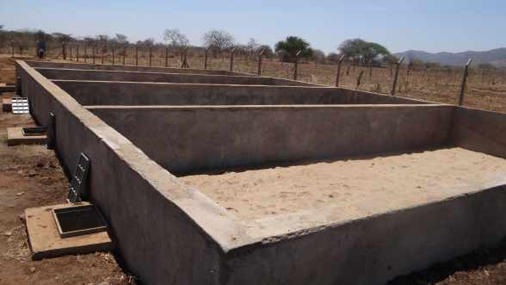
SLUDGE DRYING BEDS
TECHNICAL SPECIFICATION AND REQUIREMENTS

Slide 2
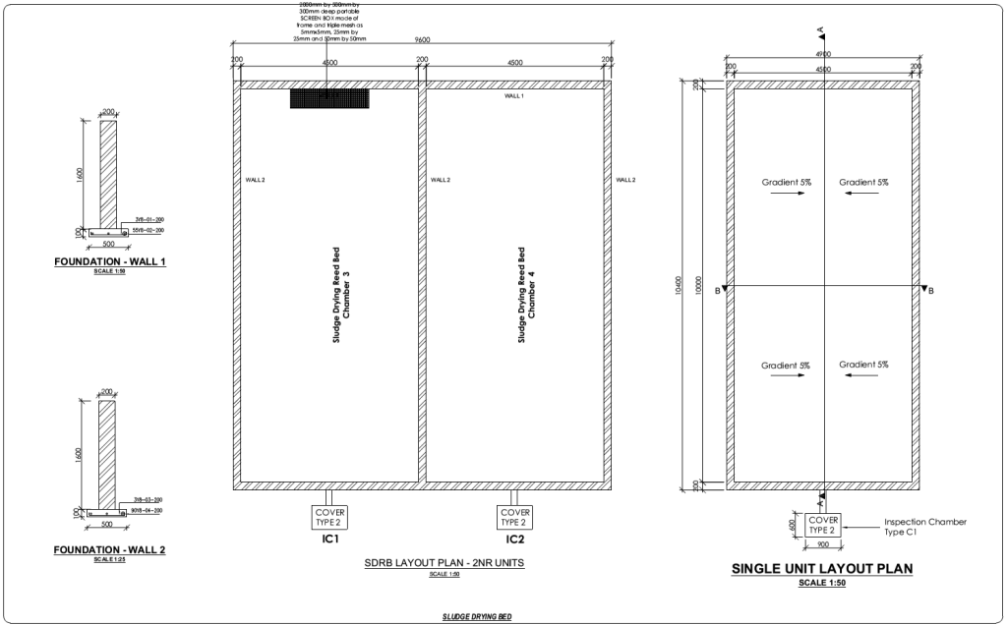

Slide 3
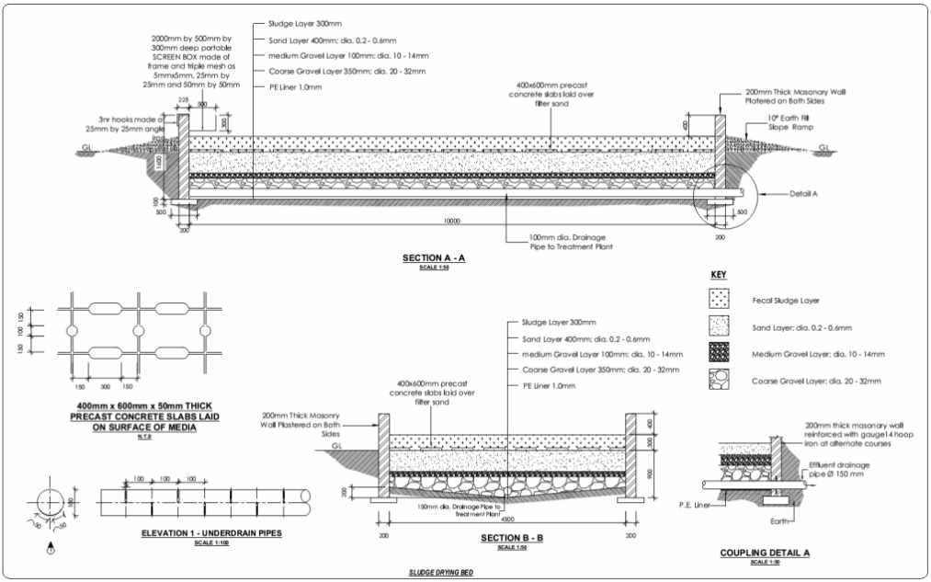

Slide 4
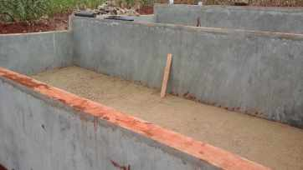
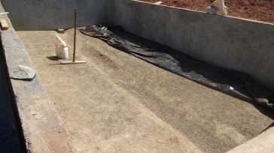
SUBSURFACE
Compact the subgrade (below the filter media) uniformly
Create a 2 sides slope towards the centre of each bed to enable drainage
The beds are placed 80 cm (1 m at the centre) below the ground level
For each bed create a 1% slope towards the inspection chamber to enable drainage
In case of a sloppy area, the 4 beds can be laid separately at different levels

Slide 5
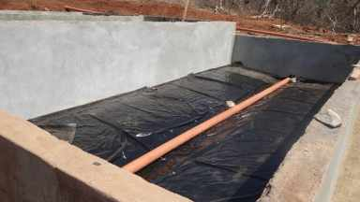
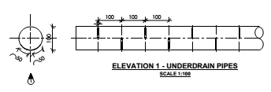
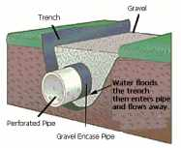
LINING MATERIAL AND UNDERDRAIN PIPE
Lining material should be the same as for the Vertical Flow Constructed Wetland
A clay layer (50mm thick) + PE liner (1 mm thick)
Well compacted subgrade, PE liner overlap of 5 to 10 cm, water tightness test before filling with filter media
Underdrain pipes: uPVC class 41 (100 mm dia.)

Slide 6
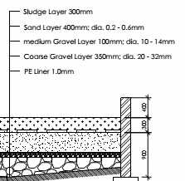
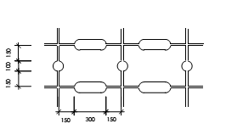
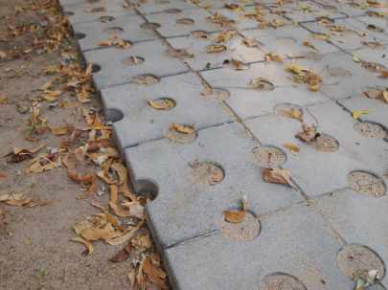
FILTER MEDIA AND SLAB
Same requirements as for VFCW: sand free of loam and silt, no sharp edges at the bottom, etc.
Precast Concrete Slab laid on top of sand layer with following dimension: 400 x 600 x 50mm thick

